Slide 1
Work and vocation Deeper Learning Track “Faith at Work: Made to Flourish” as presented at EFCA One 2015 Dr. Constantine campbell

Slide 2
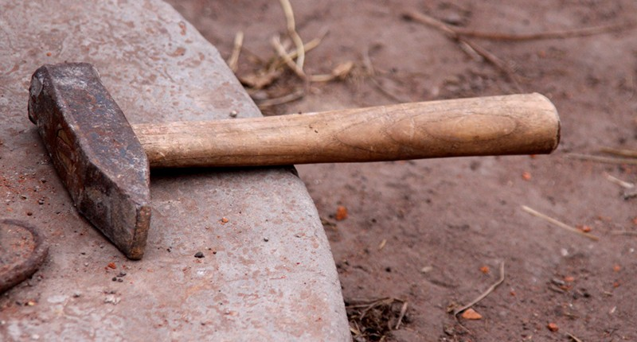
A Biblical Theology of Work
From the Garden to the City
Notes:
“Hi ho, it’s off to work we go”
Americans working harder than ever
More than anyone in industrialized world
Less vacation, longer days, retiring later
More than any other activity, even sleeping
Some love work/ hate/ in between
In the church: Deep confusion about work
Is it good to work?
Why should we work?
How work & faith relate?
Will my work last?
Or is it meaningless?

Slide 3
A Biblical Theology of Work
From the Garden to the City
Notes:
Goal of 3 sessions:
Explore robust biblical theology of work
Explore relationship between faith & work
Explore how this affects our ministry to workers
Goal of this session:
First step: biblical theology of work

Slide 4
Introduction
Aim: To outline the framework of the Bible’s teaching about work
In the beginning… God worked (Genesis 1)
Made to Work (Genesis 2)
Work is messed up (Genesis 3)
Ordinary Work (Proverbs)
Work is Futile (Ecclesiastes)
The Parable of the Talents (Matthew 25:13–40)
Paul and Work (2 Thessalonians 2:7–13)
The Work of the Lord (1 Corinthians 15:58)
Achievement and the Sons of God (Galatians 3:26–29)
Conclusion
Notes:
Aim: To outline the framework of the Bible’s teaching about work
In the beginning… God worked (Genesis 1)
Made to Work (Genesis 2)
Work is messed up (Genesis 3)
Ordinary Work (Proverbs)
Work is Futile (Ecclesiastes)
The Parable of the Talents (Matthew 25:13–40)
Paul and Work (2 Thessalonians 2:7–13)
The Work of the Lord (1 Corinthians 15:58)
Achievement and the Sons of God (Galatians 3:26–29)
Conclusion

Slide 5
1. In the beginning…God worked Genesis 1
Notes:
God: designer, worker, and creator:
Makes the heavens and earth (1:1)
Creates light (1:3)
Forms the sky and earth (1:6–10)
Makes vegetation (1:11–12)
Establishes the heavenly lights (1:14–17)
Creates living creatures in the water, in air, and on land (1:20–22)
Finally, God makes man and woman in his own image (1:26–27)
After all this activity, God rests from creating work (2:2–3).

Slide 6
1. In the beginning…God worked Genesis 1
Notes:
Principles:
Work: good thing that Creator does
Not result of fall
Work: therefore good
Rest is also good

Slide 7
1. In the beginning…God worked Genesis 1
Notes:
God achieves…
Pattern: “Let there be…” followed by “and there was”/ “it was so”
God’s intentions come to fruition:
“Let there be light, and there was light” (1:3)
“Let there be an expanse between the waters” (1:6), etc…
This is a pattern of achievement

Slide 8
1. In the beginning…God worked Genesis 1
Notes:
God also assesses his work
After creating light, he “saw that it was good” (1:4)
So in 1:10, 12, 18, 21, 25
After creating man and woman, “it was very good” (1:31)
God sets out to accomplish certain goals
He completes them
And he evaluates them as good
Intention = production = evaluation

Slide 9
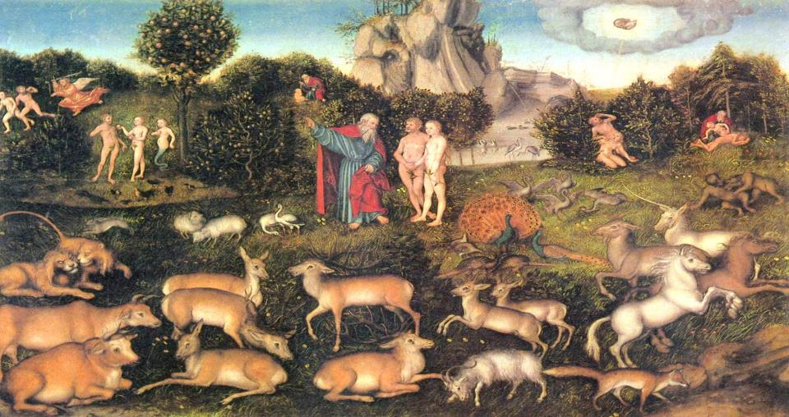
2. Made to Work Genesis 2
Notes:
God assigns a work role for the man
Genesis 2:15
“God took the man and placed him in the Garden of Eden
to work it and watch over it.”
Just as God is a worker…
So his intent for humanity is to work
In part, it is what we are made for
Again, we see that work is inherently good

Slide 10
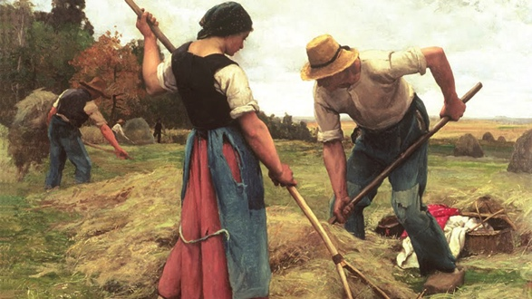
3. Work is messed up Genesis 3
Notes:
But God’s design becomes warped
The man & woman question, then reject, God’s good intentions
Create a rift between God and humanity
Genesis 3 casts overwhelming shadow over human history

Slide 11
3. Work is messed up Genesis 3
Genesis 3:17–19
“The ground is cursed because of you.
You will eat from it by means of painful labor all the days of your life.
It will produce thorns and thistles for you, and you will eat the plants
of the field. You will eat bread by the sweat of your brow until you
return to the ground, since you were taken from it,
For you are dust, and you will return to dust.”
Notes:
The consequences of the fall are spelled out:
Genesis 3:17–19
“The ground is cursed because of you. You will eat from it by means of painful labor all the days of your life. It will produce thorns and thistles for you, and you will eat the plants of the field. You will eat bread by the sweat of your brow until you return to the ground, since you were taken from it, For you are dust, and you will return to dust.”

Slide 12
3. Work is messed up Genesis 3
Genesis 3:17–19
“The ground is cursed because of you.
You will eat from it by means of painful labor all the days of your life.
It will produce thorns and thistles for you, and you will eat the plants
of the field. You will eat bread by the sweat of your brow until you
return to the ground, since you were taken from it,
For you are dust, and you will return to dust.”
Notes:
Consequences:
For Adam, consequences nearly entirely concerned with work
Work will become much more difficult
Hint of futility (death)

Slide 13
3. Work is messed up Genesis 3
Notes:
Putting Genesis 1–3 together…
Work is good
Reflected by God’s nature
And intent for humanity
But bent out of shape by sin
Work will never be the same

Slide 14
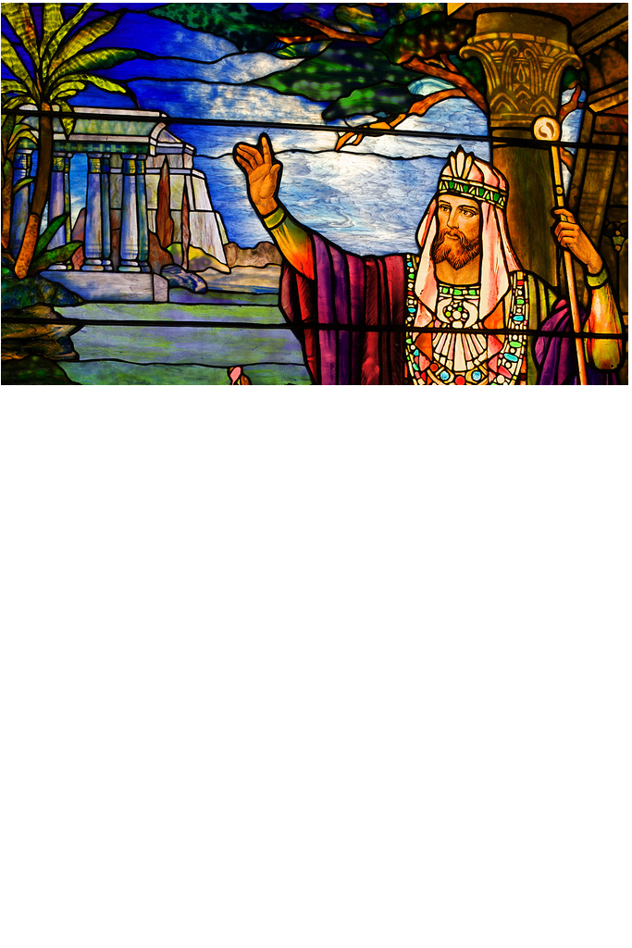
4. Ordinary work Proverbs
Notes:
Turn now to Proverbs
Snapshot of a good life lived in the kingdom
How wisdom shapes lives
Addresses several themes related to work:
Success, achievement, discipline, character

Slide 15
4. Ordinary work Proverbs
Success
“For the LORD gives wisdom; from His mouth come knowledge and understanding.
He stores up success for the upright.”
(2:6–7)
“The one who understands a matter finds success,
and the one who trusts in the LORD will be happy.”
(16:20)
“A house is built by wisdom, and it is established by understanding;
by knowledge the rooms are filled with every precious and beautiful treasure.”
(24:3–4)
Notes:
Success
“For the LORD gives wisdom; from His mouth come knowledge and understanding.
He stores up success for the upright.”
(2:6–7)
“The one who understands a matter finds success,
and the one who trusts in the LORD will be happy.”
(16:20)
“A house is built by wisdom, and it is established by understanding;
by knowledge the rooms are filled with every precious and beautiful treasure.”
(24:3–4)

Slide 16
4. Ordinary work Proverbs
Success
“For the LORD gives wisdom; from His mouth come knowledge and understanding.
He stores up success for the upright.”
(2:6–7)
“The one who understands a matter finds success,
and the one who trusts in the LORD will be happy.”
(16:20)
“A house is built by wisdom, and it is established by understanding;
by knowledge the rooms are filled with every precious and beautiful treasure.”
(24:3–4)
Notes:
Success: inherently good
Though some qualifications:
Better to be poor with integrity, than rich without it (28:6)
In general:
A blessing from God
One of the goals of living wisely

Slide 17
4. Ordinary work Proverbs
Work and diligence
“Idle hands make one poor, but diligent hands bring riches.”
(10:4)
“A lazy man doesn’t roast his game, but to a diligent man, his wealth is precious.”
(12:27)
“The plans of the diligent certainly lead to profit,
but anyone who is reckless certainly becomes poor.”
(21:5)
Notes:
Work and diligence (1)
“Idle hands make one poor, but diligent hands bring riches.”
(10:4)
“A lazy man doesn’t roast his game, but to a diligent man, his wealth is precious.”
(12:27)
“The plans of the diligent certainly lead to profit,
but anyone who is reckless certainly becomes poor.”
(21:5)

Slide 18
4. Ordinary work Proverbs
Work and diligence
“Do you see a man skilled in his work? He will stand in the presence of kings.
He will not stand in the presence of unknown men.”
(22:29)
Virtually the whole of Proverbs 31:10–31 praises the capable wife
and all her work, discipline, and achievements, culminating in 31:31:
“Give her the reward of her labor, and let her works praise her at the city gates.”
(31:31)
Notes:
Work and diligence (2)
“Do you see a man skilled in his work? He will stand in the presence of kings.
He will not stand in the presence of unknown men.”
(22:29)
Virtually the whole of Proverbs 31:10–31 praises the capable wife
and all her work, discipline, and achievements, culminating in 31:31:
“Give her the reward of her labor, and let her works praise her at the city gates.”
(31:31)

Slide 19
4. Ordinary work Proverbs
Notes:
But Proverbs: OT kingdom living
Priorities altered in kingdom of Christ
Success redefined in important ways
But success, work, diligence, character: part of the life of wisdom

Slide 20
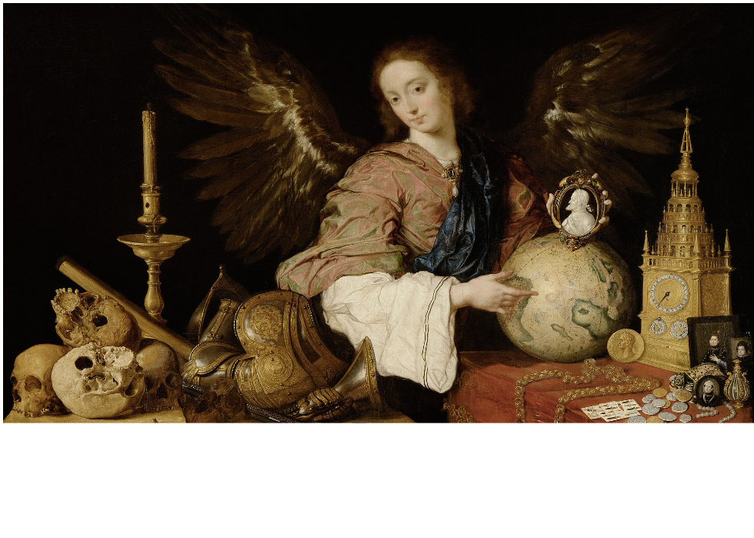
5. Work is futile Ecclesiastes
Notes:
Proverbs: if live according to wisdom, everything will work out
Job: but life’s not as simple as that
Ecclesiastes: so what? You’re going to die anyway

Slide 21
5. Work is futile Ecclesiastes
Ecclesiastes 2:4–9
“I increased my achievements. I built houses and planted vineyards for myself.
5 I made gardens and parks for myself and planted every kind of fruit tree in them.
6 I constructed reservoirs of water for myself from which to irrigate a grove of
flourishing trees. 7 I acquired male and female servants and had slaves who were
born in my house. I also owned many herds of cattle and flocks,
more than all who were before me in Jerusalem.
8 I also amassed silver and gold for myself, and the treasure of kings and provinces.
I gathered male and female singers for myself, and many concubines,
the delights of men. 9 So I became great and surpassed all who were before me
in Jerusalem; my wisdom also remained with me.”
Notes:
Ecclesiastes 2:4–9
“I increased my achievements. I built houses and planted vineyards for myself. 5 I made gardens and parks for myself and planted every kind of fruit tree in them. 6 I constructed reservoirs of water for myself from which to irrigate a grove of flourishing trees. 7 I acquired male and female servants and had slaves who were born in my house. I also owned many herds of cattle and flocks, more than all who were before me in Jerusalem. 8 I also massed silver and gold for myself, and the treasure of kings and provinces. I gathered male and female singers for myself, and many concubines,
the delights of men. 9 So I became great and surpassed all who were before me in Jerusalem; my wisdom also remained with me.”

Slide 22
5. Work is futile Ecclesiastes
Ecclesiastes 2:4–9
“I increased my achievements. I built houses and planted vineyards for myself.
5 I made gardens and parks for myself and planted every kind of fruit tree in them.
6 I constructed reservoirs of water for myself from which to irrigate a grove of
flourishing trees. 7 I acquired male and female servants and had slaves who were
born in my house. I also owned many herds of cattle and flocks,
more than all who were before me in Jerusalem.
8 I also amassed silver and gold for myself, and the treasure of kings and provinces.
I gathered male and female singers for myself, and many concubines,
the delights of men. 9 So I became great and surpassed all who were before me
in Jerusalem; my wisdom also remained with me.”
Notes:
The teacher achieved a lot
Assessed his achievements
Overtook all his predecessors
Lived according to wisdom, reaped the reward
But…

Slide 23
5. Work is futile Ecclesiastes
Ecclesiastes 2:11
“When I considered all that I had accomplished and what I had labored to achieve,
I found everything to be futile and a pursuit of the wind.
There was nothing to be gained under the sun.”
Notes:
Ecclesiastes 2:11
“When I considered all that I had accomplished and what I had labored to achieve, I found everything to be futile and a pursuit of the wind. There was nothing to be gained under the sun.”
He became a success
But all achievements are fleeting
Mist and vapour

Slide 24
5. Work is futile Ecclesiastes
Death
Throughout the book, he grapples with the overarching reality of death:
A generation goes and a generation comes (1:4)
There is no remembrance of those who lived before (1:11)
All the fruit of your work will be left to another (2:18)
All come from dust, and all return to dust (3:21)
Notes:
Death
Throughout the book, he grapples with the overarching reality of death:
A generation goes and a generation comes (1:4)
There is no remembrance of those who lived before (1:11)
All the fruit of your work will be left to another (2:18)
All come from dust, and all return to dust (3:21)
Death is the great equalizer
Wipes out all achievements
Makes your work irrelevant
Renders you back to dust

Slide 25
5. Work is futile Ecclesiastes
Notes:
Proverbs & Ecclesiastes:
Ecclesiastes: sober qualification to optimism of Proverbs
Both develop themes of Genesis 1 and 3:
Proverbs: draws on order of creation (Gen 1)
Ecclesiastes: draws on corruption of sin and death (Gen 3)
Work: to be understood through both lenses at same time
(We move now to consider the NT…)

Slide 26
6. The Parable of the talents Matthew 25:13–40
Notes:
The parable of the talents (Matthew 25:13–40)
Last parable in series about return of Jesus, and call to be ready
Deals with responsibility to serve the Master will all your resources
Final judgment brings each servant’s action to account

Slide 27
6. The Parable of the talents Matthew 25:13–40
Notes:
A man goes on a journey
Entrusts wealth to servants—“each according to his ability” (25:14–15).
First servant: five talents
(One talent = between $300,000–800,000 today)
Put it to work, gained five more (25:16)
Servant with two talents: gained two more (25:17)
But servant with one talent: buried it (25:18)
First two servants: “Well done, good and faithful servant!”
Faithfulness with a few things: leads to greater responsibility
Invitation to share in the master’s joy (25:19–23)

Slide 28
6. The Parable of the talents Matthew 25:13–40
“Master, I know you. You’re a difficult man, reaping where you haven’t sown and
gathering where you haven’t scattered seed. So I was afraid and went off and
hid your talent in the ground. Look, you have what is yours.”
Notes:
Third servant, however, tells the master,
“Master, I know you. You’re a difficult man, reaping where you haven’t sown and gathering where you haven’t scattered seed. So I was afraid and went off and hid your talent in the ground. Look, you have what is yours.”
(25:24–25)
He is thrown into the outer darkness (25:30)

Slide 29
6. The Parable of the talents Matthew 25:13–40
Craig Blomberg:
(1) God entrusts his resources to his people and expects them to be good stewards
(2) Those who faithfully work for the kingdom and enhance it will be both
commended and rewarded for their efforts
(3) Those who do not use their gifts and the kingdom resources will be
condemned and separated from the very presence of God.
Craig L. Blomberg, Interpreting the Parables (Downer’s Grove: IVP, 1990), 214
Notes:
Craig Blomberg on the meaning of the parable:
(1) God entrusts his resources to his people and expects them to be good stewards
(2) Those who faithfully work for the kingdom and enhance it will be both
commended and rewarded for their efforts
(3) Those who do not use their gifts and the kingdom resources will be
condemned and separated from the very presence of God.

Slide 30
6. The Parable of the talents Matthew 25:13–40
Notes:
Some reflections on work…
Talents don’t belong to servants; but are entrusted
We are stewards
Faithfulness leads to greater entrusting (more work)
Doing nothing: not right way to handle what’s entrusted
Not all work, and no play
Share in your master’s joy! (25:21, 23)
Productive work and wise management please God
Using resources entrusted is good
God’s pleasure is shared with us

Slide 31
7. Paul and work 2 Thessalonians 3:7–13
Notes:
We turn now to consider Paul’s understanding of work…

Slide 32
7. Paul and work 2 Thessalonians 3:7–13
“For you yourselves know how you must imitate us: We were not irresponsible among you; we did not eat anyone’s food free of charge; instead, we labored and struggled, working night and day, so that we would not be a burden to any of you. It is not that we don’t have the right to support, but we did it to make ourselves an example to you so that you would imitate us. In fact, when we were with you, this is what we commanded you: “If anyone isn’t willing to work, he should not eat.” For we hear that there are some among you who walk irresponsibly, not working at all, but interfering with the work of others. Now we command and exhort such people by the Lord Jesus Christ that quietly working, they may eat their own food. Brothers, do not grow weary in doing good.”
Notes:
2 Thess 3:7–13
“For you yourselves know how you must imitate us: We were not irresponsible among you; we did not eat anyone’s food free of charge; instead, we labored and struggled, working night and day, so that we would not be a burden to any of you. It is not that we don’t have the right to support, but we did it to make ourselves an example to you so that you would imitate us. In fact, when we were with you, this is what we commanded you: “If anyone isn’t willing to work, he should not eat.” For we hear that there are some among you who walk irresponsibly, not working at all, but interfering with the work of others. Now we command and exhort such people by the Lord Jesus Christ that quietly working, they may eat their own food. Brothers, do not grow weary in doing good.”

Slide 33
7. Paul and work 2 Thessalonians 3:7–13
“For you yourselves know how you must imitate us: We were not irresponsible among you; we did not eat anyone’s food free of charge; instead, we labored and struggled, working night and day, so that we would not be a burden to any of you. It is not that we don’t have the right to support, but we did it to make ourselves an example to you so that you would imitate us. In fact, when we were with you, this is what we commanded you: “If anyone isn’t willing to work, he should not eat.” For we hear that there are some among you who walk irresponsibly, not working at all, but interfering with the work of others. Now we command and exhort such people by the Lord Jesus Christ that quietly working, they may eat their own food. Brothers, do not grow weary in doing good.”
Notes:
Some are not willing to work
Interfere with work of others (v.11)
Commands them: work “quietly” (without fuss)
Provide for themselves (v.13)
Serious: don’t associate with any who disobeys (v.14)

Slide 34
7. Paul and work 2 Thessalonians 3:7–13
“For you yourselves know how you must imitate us: We were not irresponsible among you; we did not eat anyone’s food free of charge; instead, we labored and struggled, working night and day, so that we would not be a burden to any of you. It is not that we don’t have the right to support, but we did it to make ourselves an example to you so that you would imitate us. In fact, when we were with you, this is what we commanded you: “If anyone isn’t willing to work, he should not eat.” For we hear that there are some among you who walk irresponsibly, not working at all, but interfering with the work of others. Now we command and exhort such people by the Lord Jesus Christ that quietly working, they may eat their own food. Brothers, do not grow weary in doing good.”
Notes:
Principles:
Work is good; idleness is bad
Work: fundamental part of living in world (Gen 2)
Provision: a key outcome produced by work

Slide 35
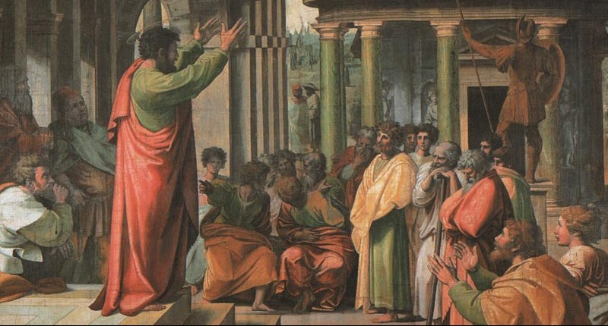
8. The Work of the Lord 1 Corinthians 15:58
“Always give yourselves fully to the work of the Lord, because you know that your labor in the Lord is not in vain.”
Notes:
Now turn to key text for thinking about faith and work
At end of discussion of resurrection in 1 Corinthians 15 Paul says…

Slide 36
8. The Work of the Lord 1 Corinthians 15:58
“Always give yourselves fully to the work of the Lord, because you know that your labor in the Lord is not in vain.”
Notes:
“Always give yourselves fully to the work of the Lord, because you know that your labor in the Lord is not in vain.”
Crucial verse for thinking about faith and work
The issues:
Believers to give themselves fully to the work of Lord
Labor in Lord is not in vain
But what is the “work of Lord” and “labor in Lord”?

Slide 37
8. The Work of the Lord 1 Corinthians 15:58
Two schools of thought
Position 1
Position 2
Notes:
Two schools of thought
Position 1: Paul affirms the value of Christian ministry
Ministry work not in vain
Normally understood to elevate ministry above other work
Perhaps implies other work is in vain (cf. Ecclesiastes)
Contributes to sacred / secular divide?

Slide 38
8. The Work of the Lord 1 Corinthians 15:58
Two schools of thought:
Position 1
Position 2
Notes:
Position 2: All work believers do is “work of the Lord”
No distinction between sacred and secular
Work is inherently good (Gen 2)
Doesn’t need to be Christianized to be worthwhile
Any work done by believers is not in vain
So what does Paul really mean?

Slide 39
8. The Work of the Lord 1 Corinthians 15:58
A mediating position:
The “work of the Lord” is ministry
But this does not mean other work is in vain
Notes:
The “work of the Lord” is ministry:
1 Cor 16:10: Timothy is “working the work of the Lord, as I am”
Timothy is Paul’s coworker in ministry
Other “coworkers” do gospel ministry (Rom 16:3, 9, 21; 1 Cor 3:9; 2 Cor 8:23; Phil 2:25; 4:3; Col 4:11; Phlm 1, 24)
1 Thess 5:12: those who “labor in the Lord” are leaders of the congregation
Labor refers to ministry (Rom 16:12; Gal 4:11; Phil 2:16; Col 1:29; 1 Tim 5:17)

Slide 40
8. The Work of the Lord 1 Corinthians 15:58
A mediating position:
The “work of the Lord” is ministry
But this does not mean other work is in vain
Notes:
Context of 1 Corinthians 15:
Discussion of resurrection body (15:35–57)
Dead in Christ: raised immortal, imperishable
Work in Lord not in vain because people will live forever
Through gospel proclamation, teaching word, edification, encouragement:
People found mature in Christ
They are the imperishable fruit of such work
Christian ministry is a special kind of work

Slide 41
8. The Work of the Lord 1 Corinthians 15:58
A mediating position:
The “work of the Lord” is ministry
But this does not mean other work is in vain
Notes:
What about other work?
Right to downplay other work then?
•No (see previous 36 slides!)
But what if other work is not eternal?
•Still eternal consequences (judgment)
•Not everything good and important is eternal (marriage)
All work matters to God
If it matters to him, it should matter to us
Even if fruit doesn’t last forever
If please him in our work, that matters for eternity

Slide 42
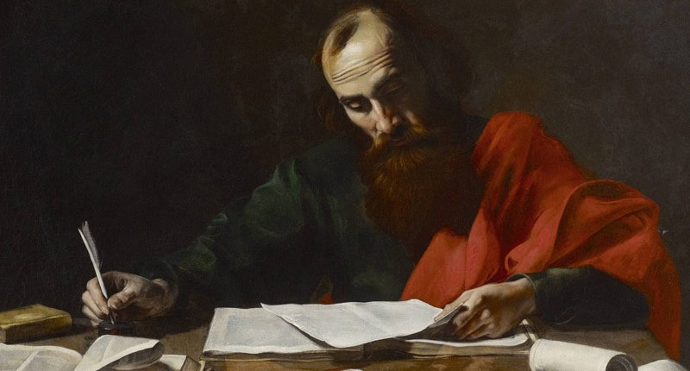
9. Achievement and the Sons of God Galatians 3:26–29
Notes:
One final consideration… work and identity

Slide 43
9. Achievement and the Sons of God Galatians 3:26–29
We are Sons of God
“For you are all sons of God through faith in Christ Jesus.
For as many of you as have been baptized into Christ have put on Christ like a garment. There is no Jew or Greek, slave or free, male or female; for you are all one in Christ Jesus. And if you belong to Christ, then you are Abraham’s seed, heirs according to the promise.”
Notes:
We are Sons of God (Gal 3:26–29)
“For you are all sons of God through faith in Christ Jesus. For as many of you as have been baptized into Christ have put on Christ like a garment. There is no Jew or Greek, slave or free, male or female; for you are all one in Christ Jesus. And if you belong to Christ, then you are Abraham’s seed, heirs according to the promise.”

Slide 44
9. Achievement and the Sons of God Galatians 3:26–29
We are Sons of God
“For you are all sons of God through faith in Christ Jesus.
For as many of you as have been baptized into Christ have put on Christ like a garment. There is no Jew or Greek, slave or free, male or female; for you are all one in Christ Jesus. And if you belong to Christ, then you are Abraham’s seed, heirs according to the promise.”
Notes:
We are Sons of God
“No Jew, Greek, etc.” does not eradicate difference, but erases status
We all share the highest possible status as sons
Our world: high premium on achievement
But our status cannot be measured by that
Underachievers and overacheivers: all valued members of God’s family
Status entirely determined by being in Christ
(True even for people not in ministry!)

Slide 45
10. Conclusion
Notes:
Some key points:
Work inherently good
But warped by sin, death
Understood in light of…
gifting, responsibility, union with Christ, resurrection, judgment
Ministry is a special kind of work (and that’s ok)
Status not determined by work
Goal of all work: to bring glory to God
(End)

